Slide 1
Attention
Chad C. Williams

Slide 2
+

Slide 5
Posner (1980). Quarterly Journal of Experimental Psychology

Slide 6
Attention
Alerting: Signal of preparatory attentional need
Orienting: Control of attention towards location or modality
Executive (Focal Attention): Top down influence to maintain important information
Petersen and Posner. (2012). Annual Review of Neuroscience.

Slide 7
Posner (1980). Quarterly Journal of Experimental Psychology

Slide 8
Composition of Attention
Multi-faceted mechanism, with distinct neural localization and neurotransmitter influence
Each component of attention is thought to be a network
Petersen and Posner. (2012). Annual Review of Neuroscience.

Slide 9
Alerting
A ‘when’ signal.
Using a warning signal to switch from a resting state in favour of a preparatory state.
Diverse system of brain regions, guided by norepinephrine.
Example of Task: Prime participants that the target is coming improves reaction times.
Petersen and Posner. (2012). Annual Review of Neuroscience.

Slide 10
Orienting
A ‘where’ signal.
Used to prioritize information (e.g., a target) while ignoring distractors.
Can be dynamic, where orientation must be disengaged and reoriented.
Also functions to orientate across modalities.
Diverse system of brain regions, guided by acetylcholine.
Example of Task: Present blue and green coloured circles where blue is the target. In presence of a distracting red circle, reaction times decrease.
Petersen and Posner. (2012). Annual Review of Neuroscience.

Slide 11
Executive
A ‘processing’ signal.
Detecting/Processes target which will use limited cognitive resources.
Generally – conflict monitoring and cognitive control in the context of attentional focus.
Top-down regulation.
Dynamic involvement of cognition.
Task switching (instructions), elongated top-down influence, feedback processing.
Diverse system of brain regions, guided by serotonin.
Example of Task: Flanker Task
Petersen and Posner. (2012). Annual Review of Neuroscience.

Slide 12
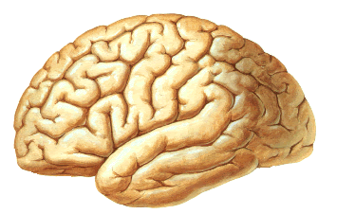
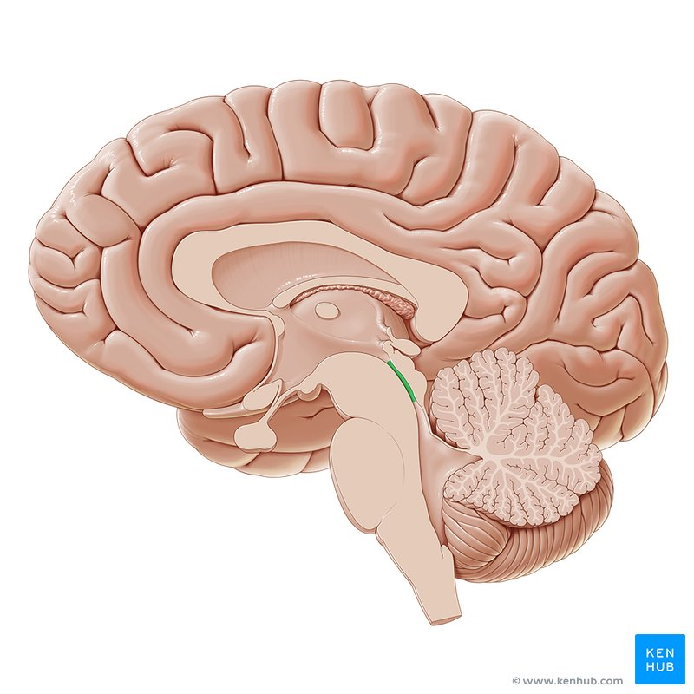
Anatomy of Alerting
Parietal Cortex
Lateral Frontal Cortex
Locus
Coeruleus
Heavily right hemisphere
Petersen and Posner. (2012). Annual Review of Neuroscience.

Slide 13
Anatomy of Alerting
Locus Coeruleus: Source of Norepinephrine
Frontal Cortex: Dorsal stream – preparing for orientation
Parietal Areas: Dorsal stream – preparing for orientation

Slide 14
Anatomy of Orienting
Ventral Frontal Cortex
Temporoparietal junction
Frontal Eye Field
Superior Parietal Lobule
Interparietal Sulcus
Basal
Forebrain
Petersen and Posner. (2012). Annual Review of Neuroscience.

Slide 15
Anatomy of Orienting
Basal Forebrain: Source of Acetylcholine
Frontal Eye Field: Dorsal Stream – controlling the location of covert attention
Interparietal Sulcus: Dorsal Stream – controlling the location of attention
Ventral Frontal Cortex: Involved in disengagement of attention
Temporoparietal Junction: Involved in reorientation of attention
Superior Parietal Lobe: Shifting attention to a target.

Slide 16
Anatomy of Executive
Parietal Cortex
ACC
Medial Frontal Cortex
Lateral Frontal Cortex
Anterior Insula
Petersen and Posner. (2012). Annual Review of Neuroscience.

Slide 17
Anatomy of Executive
ACC: Target detection and awareness. Conflict detection/ Inhibition of salient non-targets. Sustained maintenance
Anterior Insula: Sustained maintenance
Medial Frontal Cortex: Target detection and awareness. Sustained maintenance.
Lateral Frontal Cortex: Conflict monitoring, goal-orientation
Parietal Cortex: Goal-orientation

Slide 18
Alterting + Orienting + Executive
Ventral Frontal Cortex
Temporoparietal junction
Alerting + Executive
Parietal Cortex
Alerting
Orienting
Executive
ACC
Anterior Insula
Frontal Eye Field
Superior Parietal Lobule
Medial Frontal Cortex
Locus
Coeruleus
Lateral Frontal Cortex
Interparietal Sulcus
Basal
Forebrain
Petersen and Posner. (2012). Annual Review of Neuroscience.

Slide 19
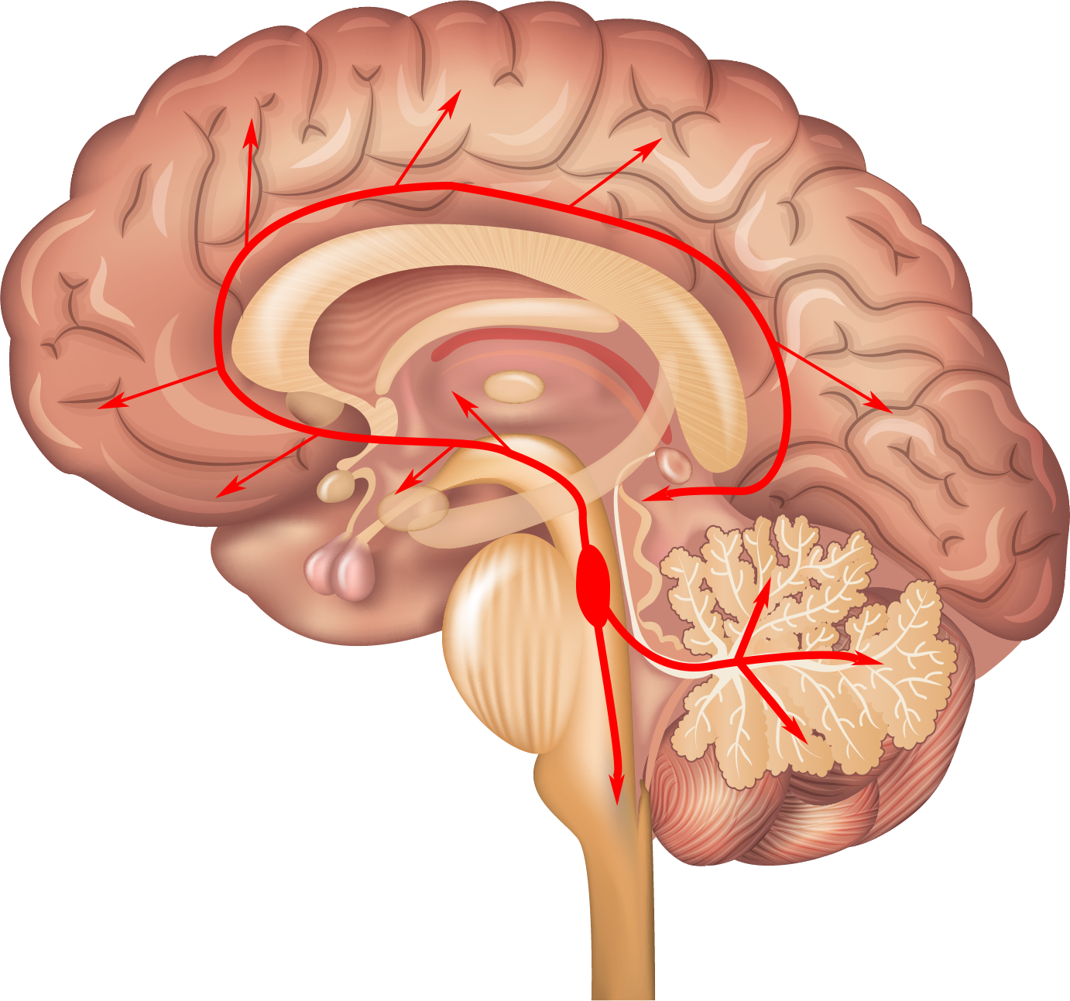
Neurotransmitter of Alerting (Norepinephrine)
Petersen and Posner. (2012). Annual Review of Neuroscience.

Slide 20
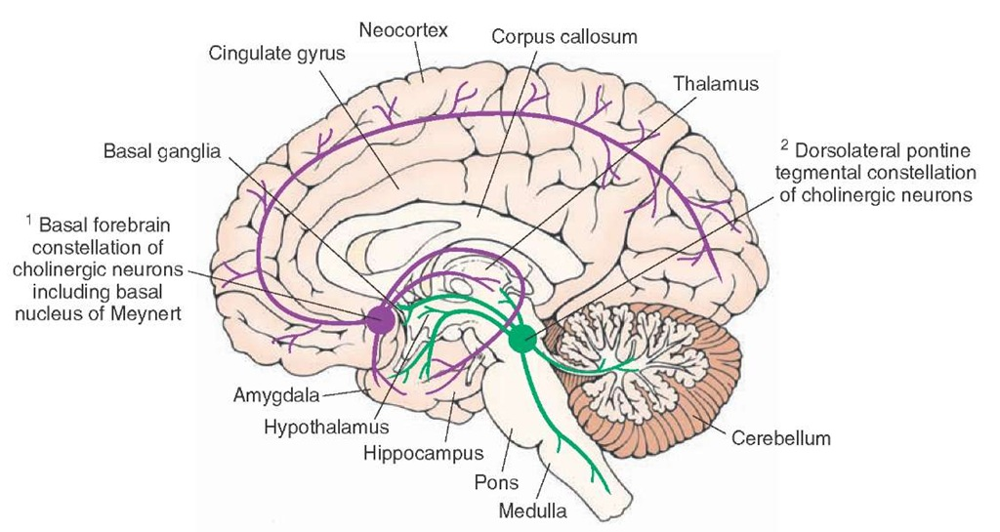
Neurotransmitter of Orienting (Acetylcholine)
Petersen and Posner. (2012). Annual Review of Neuroscience.

Slide 21
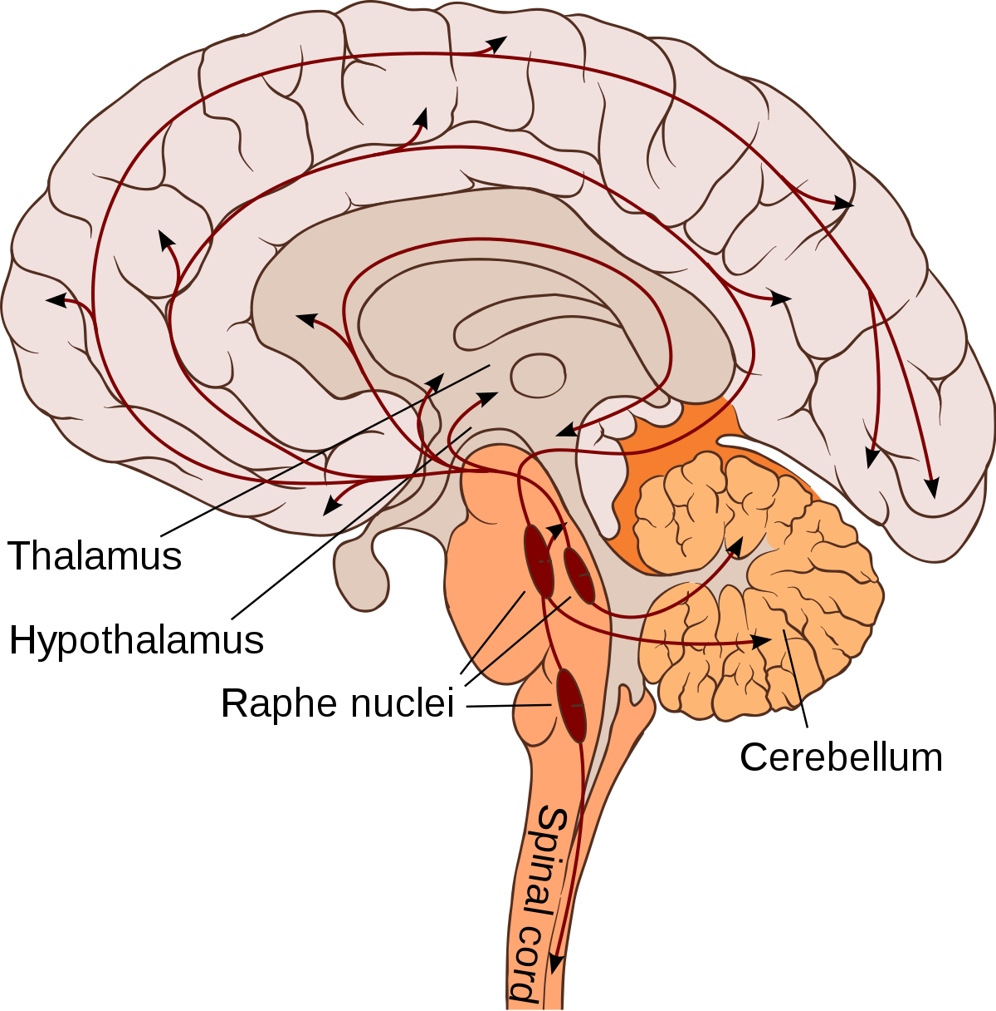
Neurotransmitter of Executive (Serotonin)
Pennanen (2013). Nautre Neuroscience

Slide 22
Dissociative Neurotransmitters
Research Question: Which neurotransmitters are involved in alerting and orienting, and are they dissociable?
Task: Cued detection task
Manipulation: Norepinephrine (NE)/ Acetylcholine (AC) blockers
Measurement: Reaction time
Results:
NE blocker: Increases alerting effect, not orienting effect
AC blocker: Increases orienting effect, not alerting effect
Conclusion: Independent systems governed by different NTs
Davidson & Marrocco (2000). Journal of Neurophysiology

Slide 23
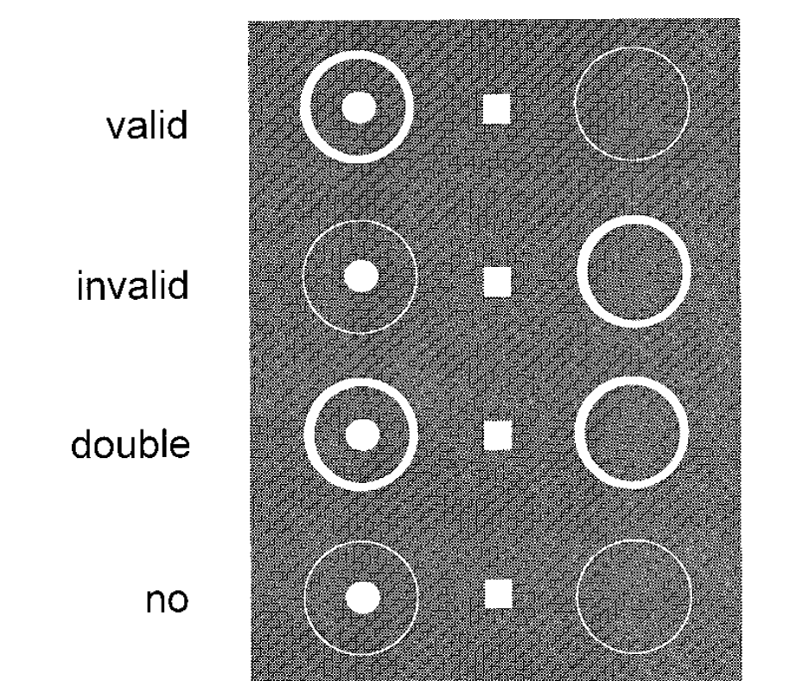
Task
Alerting and orienting
Alerting w/o orienting
No warning or orienting

Slide 24
Task
Alerting Effect:
Double cue – No cue
Orienting Effect:
Valid cue – Double cue

Slide 25
Dissociative Neurotransmitters
Research Question: Which neurotransmitters are involved in alerting and orienting, and are they dissociable?
Task: Cued detection task
Manipulation: Norepinephrine (NE)/ Acetylcholine (AC) blockers
Measurement: Reaction time
Results:
NE blocker: Increases alerting effect, not orienting effect
AC blocker: Increases orienting effect, not alerting effect
Conclusion: Independent systems governed by different NTs
Davidson & Marrocco (2000). Journal of Neurophysiology

